Slide 1

What’s new in Microsoft Intune

Slide 2


Marius A. Skovli
CTGlobal Principal Consultant and Microsoft Enterprise Mobility MVP
mas@ctglobalservices.com @MariusSkovli

Slide 3
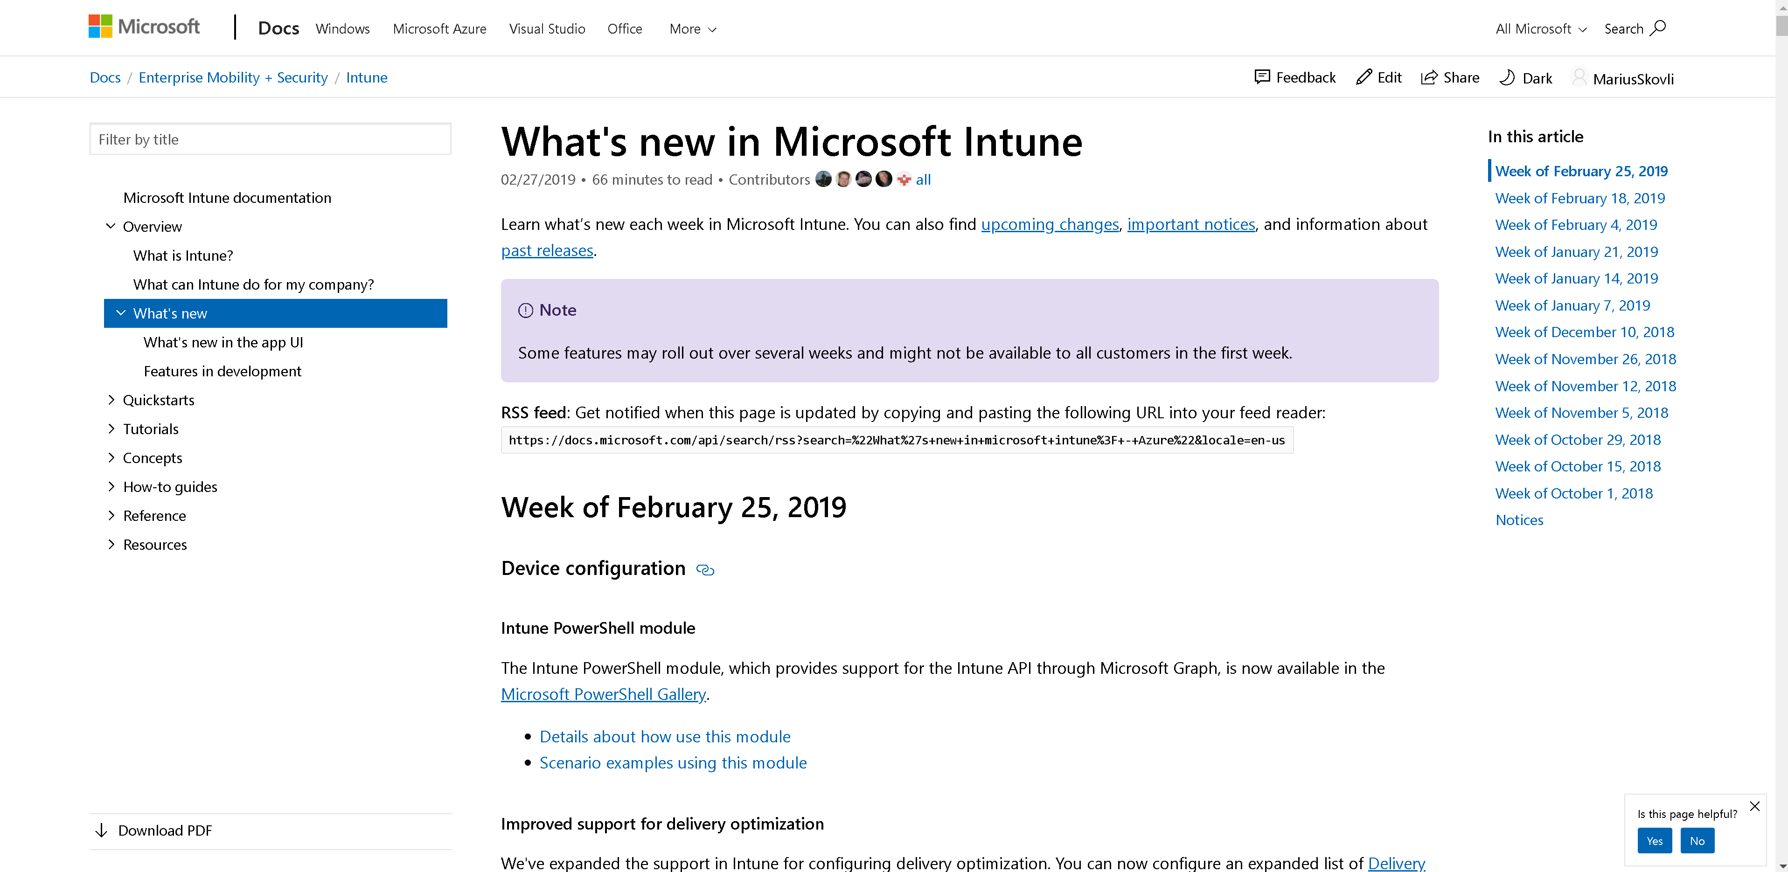
https://docs.microsoft.com/en-us/intune/whats-new

Slide 4
Impossible to cover all new features in 30 min ☺ These "gems" are worth mentioning
Remotely lock uncompliant devices
Administrative templates (Public Preview)
Security Baseline (Public Preview)
Issue SCEP certificates to user-less devices
Autopilot Hybrid Azure AD join (Preview)
Android: Corporate-owned, fully managed user devices (Preview)
BitLocker policy enhancements (also some for Windows Pro)
PowerShell scripts can run in a 64-bit host on 64-bit devices
New operational logs (Preview), and ability to send logs to Azure Monitor services
Power BI Compliance app
Intune PowerShell module available in Microsoft PowerShell Gallery
https://docs.microsoft.com/en-us/intune/whats-new

Slide 5
Impossible to cover all new features in 30 min ☺ These "gems" are worth showing
Remotely lock uncompliant devices
Administrative templates (Public Preview)
Security Baseline (Public Preview)
Issue SCEP certificates to user-less devices
Autopilot Hybrid Azure AD join (Preview)
Android: Corporate-owned, fully managed user devices (Preview)
BitLocker policy enhancements (also some for Windows Pro)
PowerShell scripts can run in a 64-bit host on 64-bit devices
New operational logs (Preview), and ability to send logs to Azure Monitor services
Power BI Compliance app
Intune PowerShell module available in Microsoft PowerShell Gallery
https://docs.microsoft.com/en-us/intune/whats-new

Slide 6
Security baseline
A security baseline includes the best practices and recommendations on settings that impact security.
Intune partners with the same Windows security team that creates group policy security baselines.
These recommendations are based on guidance and extensive experience.
Notes:
If you're brand new to Intune, and not sure where to start, then security baselines gives you an advantage. You can quickly create and deploy a secure profile, knowing that you're helping protect your organization's resources and data.
If you currently use group policy, migrating to Intune for management is much easier with these baselines. These baselines are natively built in to Intune, and include a modern management experience.
Note: When using co-managed devices, you must switch the Device configuration workload (its settings) to Intune

Slide 7



Security baseline process
Microsoft Security Assurance
Applicable for MDM/ AADJ?
Microsoft GP based security baseline
Yes
Microsoft MDM security baseline
External security experts
No
Microsoft Companion GPO Security baseline
Customer input
https://docs.microsoft.com/en-us/intune/whats-new

Slide 8

Demo

Slide 9
Windows Autopilot // User-Driven deployment with Hybrid Azure AD
Prerequisites
DJ Windows Server
Intune Connector for Active Directory (Preview)
Autopilot Profile assigned to a (Dynamic) Group
OU in AD where we can add the H-AADJ device
Connected to Corporate network (AD) (no VPN)
Windows 10 Oktober 2018 update

Slide 10
Windows Autopilot // User-Driven deployment with Hybrid Azure AD
Intune
Windows Autopilot Deployment Service
DC
Offline Domain Join Connector
Complete Join over corp net
Receive ODJ
MDM enrollment
Autopilot profile
Hardware ID
Receive GPOs over corp net
IT Admin
Employee unboxes device, self-deploys

Slide 11
Demo

Slide 12
https://docs.microsoft.com/en-us/intune/whats-new

